Slide 1

Back to Basics
Principles of Sound

Slide 2
Today
What is Sound?
Wave Equation
Harmonic oscillator
Linear wave equation
Boundary conditions
Measurements (start)
Break!
Journal Club

Slide 3
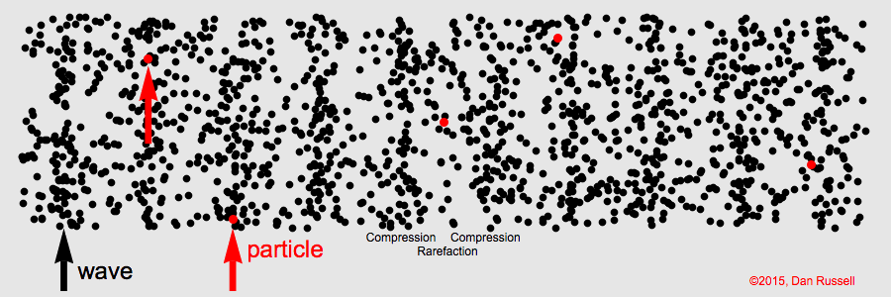
What is sound
Changes in density (compression and expansion)
Density, elasticity, displacement, velocity, acceleration
Notes:
Pressure, varies in three dimensional space so we but we can simplify down to one dimensional space

Slide 4
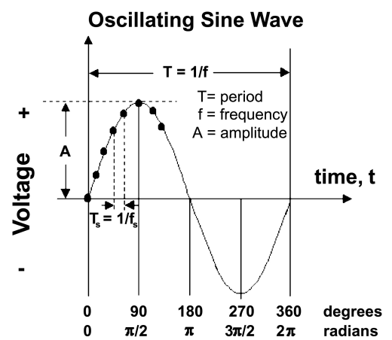
Critical measures:
Amplitude (A, unitless),
Wavelength (λ, m)
Period (τ,s)
Phase (ϕ, radians)
k - the wave number (1/λ),
ω - angular frequency (π/τ)
C = speed of sound /phase speed
Notes:
Speed of Sound: A physical property of the medium, determining how fast sound waves travel.
Phase Speed: Describes how quickly the phase of a specific wave component moves, often related to the speed of sound in non-dispersive media.
In acoustics, they are effectively equivalent in non-dispersive media but may diverge in more complex situations, such as in dispersive or structured media (e.g., waveguides, layered materials).

Slide 5
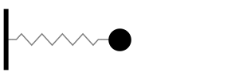


The wave equation
Harmonic Oscillator- mass and spring
$$f=ma$$
Newtonian Force
$$f=−sx$$
Restoring Force
https://www.acs.psu.edu/drussell/Demos/SHO/mass.html

Slide 6
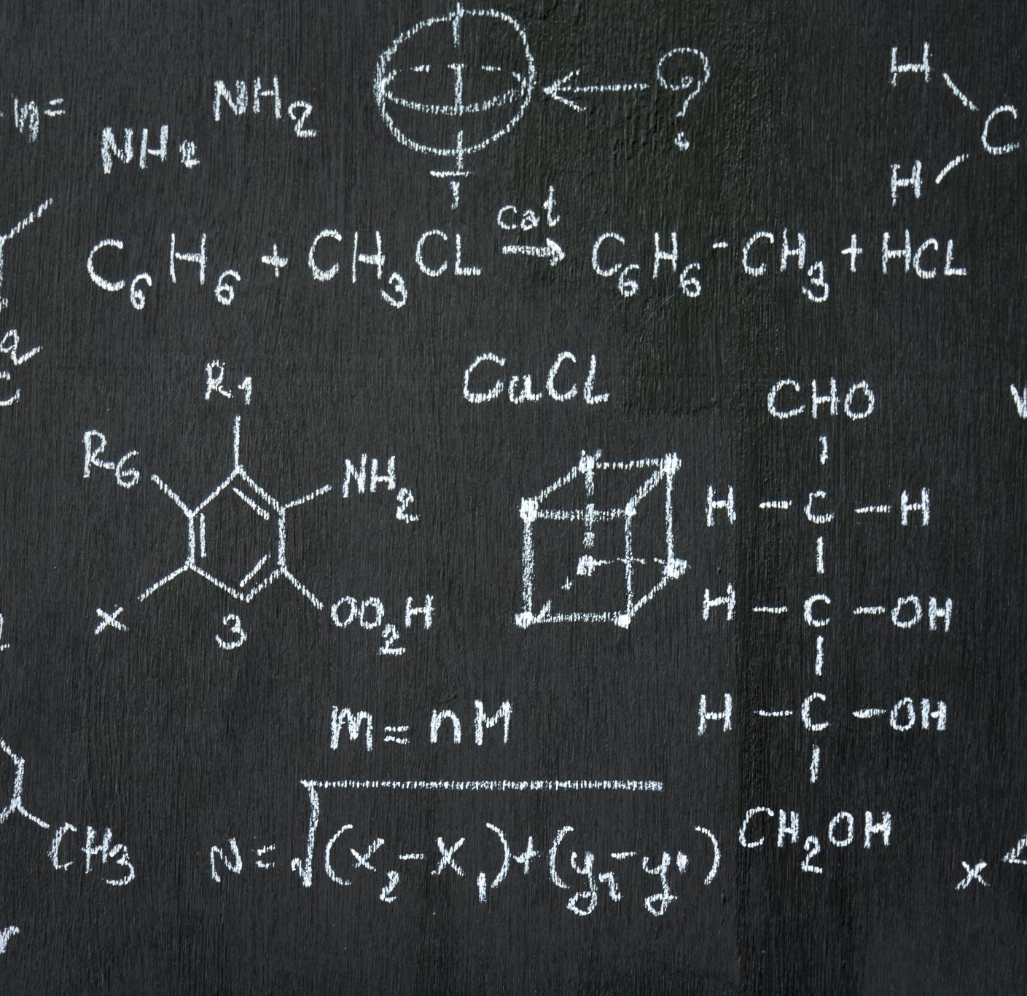
MATH BREAKOUT!
Derive Harmonic Oscillator 1

Slide 7
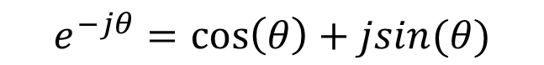

Complex Notation, Another Solution
$$j=\sqrt{−1}$$
$$e^{−jθ}=\cos\left(θ\right)+jsin(θ)$$
Euler’s equation (popular guy)
$$Real\left\{e^{−jθ}\right\}=\cos\left(θ\right)$$
$$Imaginary\left\{e^{−jθ}\right\}=jsin(θ)$$
$${{x=A}_{1}e}^{jωt}+{A_{2}e}^{−jωt}$$

Slide 8
MATH BREAKOUT!
Derive Harmonic Oscillator 2

Slide 9
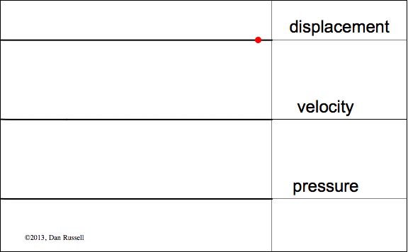
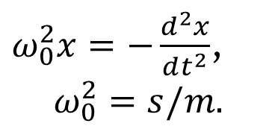
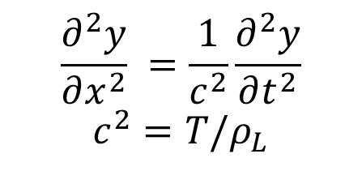
The wave equation
$ω_{0}^{2}x=−\frac{d^{2}x}{dt^{2}}$,
$$ω_{0}^{2}=s/m$$
0- DOF
$$\frac{∂^{2}y}{∂x^{2}} =\frac{1}{c^{2}}\frac{∂^{2}y}{∂t^{2}}$$
$$c^{2}=T/ρ_{L}$$
1- DOF
How do we solve? Assume a solution (educated guess)
https://www.acs.psu.edu/drussell/Demos/SHO/mass.html

Slide 10
MATH BREAKOUT!
Validate solution for linear wave equation

Slide 11
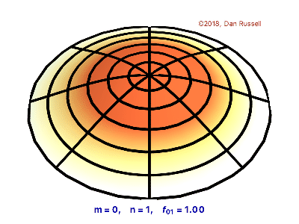
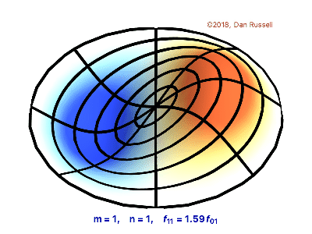
2- DOF?

Slide 12
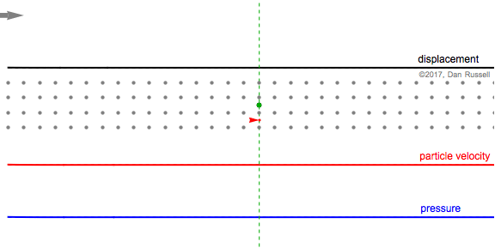
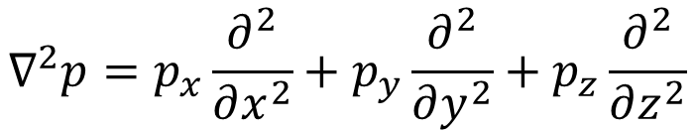
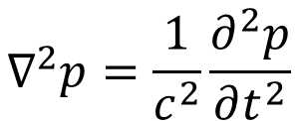
The wave equation
$ω_{0}^{2}x=−\frac{d^{2}x}{dt^{2}}$,
$$ω_{0}^{2}=s/m$$
0- DOF
$$\frac{∂^{2}y}{∂x^{2}} =\frac{1}{c^{2}}\frac{∂^{2}y}{∂t^{2}}$$
$$c^{2}=T/ρ_{L}$$
1- DOF
3- DOF
$$∇^{2}p=\frac{1}{c^{2}}\frac{∂^{2}p}{∂t^{2}}$$
$$∇^{2}p=p_{x}\frac{∂^{2}}{∂x^{2}}+p_{y}\frac{∂^{2}}{∂y^{2}}+p_{z}\frac{∂^{2}}{∂z^{2}}$$
https://www.acs.psu.edu/drussell/Demos/SHO/mass.html

Slide 13
MATH BREAKOUT!
Laplacians and the 3d wave equation

Slide 14
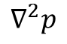
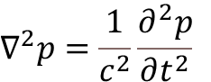
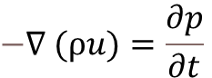
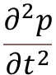
$$−∇ (ρu)=\frac{∂p}{∂t}$$
A change in particle velocity leads to a change in pressure. The pressure drives the particle motion, which feeds back into pressure changes, completing the cycle of wave propagation.
$$∇^{2}p=\frac{1}{c^{2}}\frac{∂^{2}p}{∂t^{2}}$$
$$∇^{2}p$$
How the second derivative of pressure varies spatially in all directions.
$$\frac{∂^{2}p}{∂t^{2}}$$
how pressure changes over time (its second derivative with respect to time)
if pressure varies spatially, it drives temporal acceleration

Slide 15
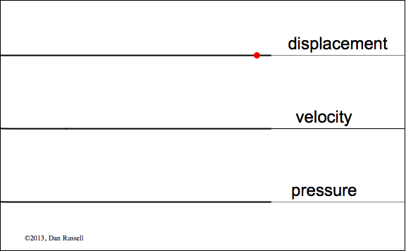
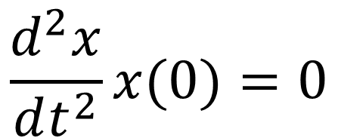
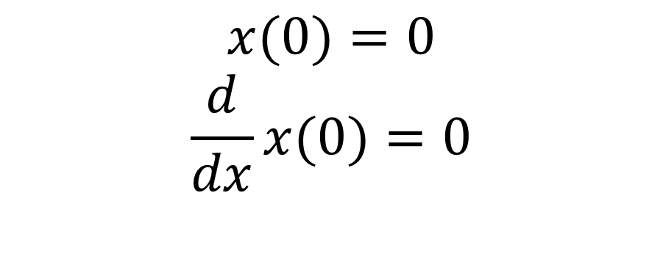
Boundary Conditions
Rigid, fixed; Displacement & velocity=0
$$x(0)=0$$
$$\frac{d}{dx}x(0)=0$$
Free, pressure release; pressure/acceleration =0
$$\frac{d^{2}x}{dt^{2}}x(0)=0$$
https://www.acs.psu.edu/drussell/Demos/SHO/mass.html

Slide 16
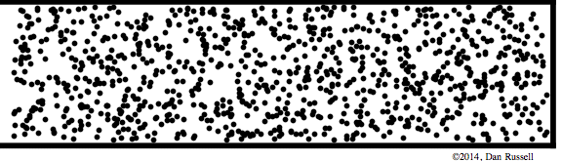
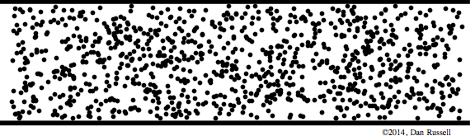
Boundary Conditions
Rigid, fixed; Displacement & velocity=0
Free, pressure release; pressure =0
https://www.acs.psu.edu/drussell/Demos/SHO/mass.html

Slide 17
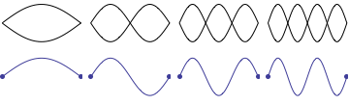

Modes
Patterns of vibration or wave propagation that exist in a system
Depend on initial geometry, boundary conditions, physical properties of the medium
Boundary: displacement fixed at both ends
$$f_{n}=\frac{nc}{2L}$$
Notes:
L = string length
n = mode number
C = speed of wave on the string

Slide 18
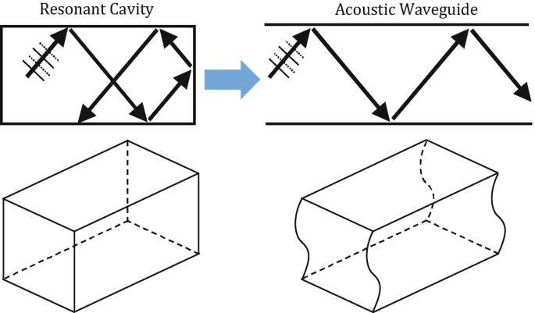
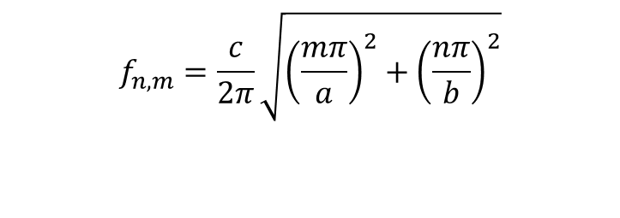
Acoustic Modes in Underwater Channels
$$f_{n,m}=\frac{c}{2π}\sqrt{{\left(\frac{mπ}{a}\right)}^{2}+{\left(\frac{nπ}{b}\right)}^{2}}$$
Notes:
a, b, dimensions of the channel

Slide 19
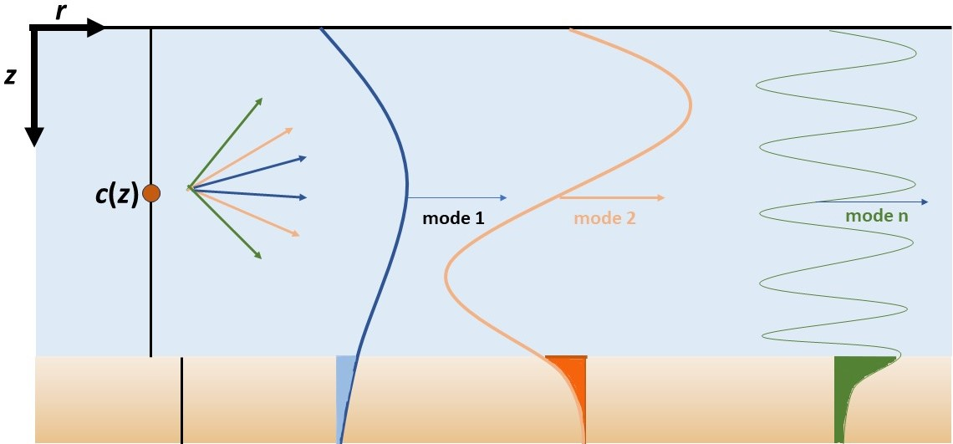
Acoustic Modes in Underwater Channels
Notes:
What is the boundary condition at the surface?
What is the boundary condition at the bottom?

Slide 20
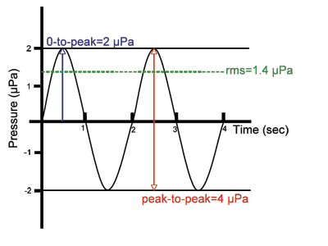
Measurements
0-to peak
RMS
Peak-to-peak

Slide 21
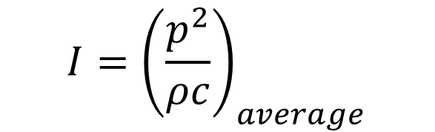

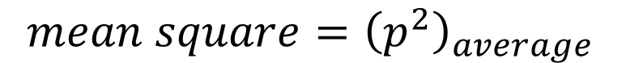
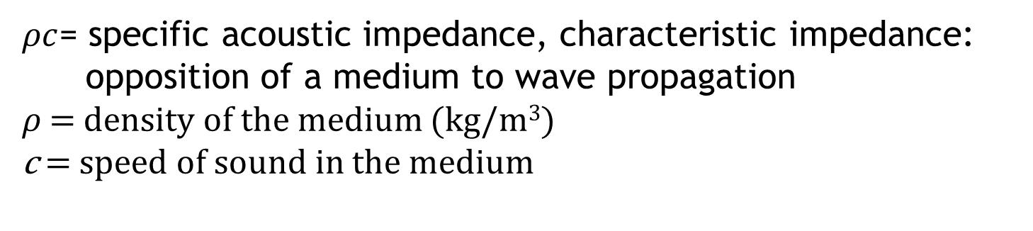
Measurements
Intensity- amount of energy transmitted per unit time through a unit area
$$I={\left(\frac{p^{2}}{ρc}\right)}_{average}$$
$$mean square={\left(p^{2}\right)}_{average}$$
$${rms=\sqrt{p^{2}}}_{average}$$
$ρc$= specific acoustic impedance, characteristic impedance:
opposition of a medium to wave propagation
𝜌 = $density of the medium$ (kg/m³)
c = speed of sound in the medium

Slide 22
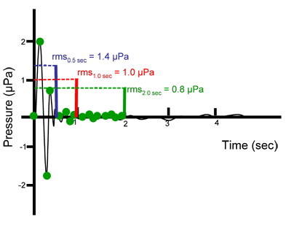
Impulsive Signals
Duration over which signal is averaged | rms pressure
0.5 sec | 1.4 µPa
1 sec | 1.0 µPa
2 sec | 0.8 µPa
www.dosits.org

Slide 23
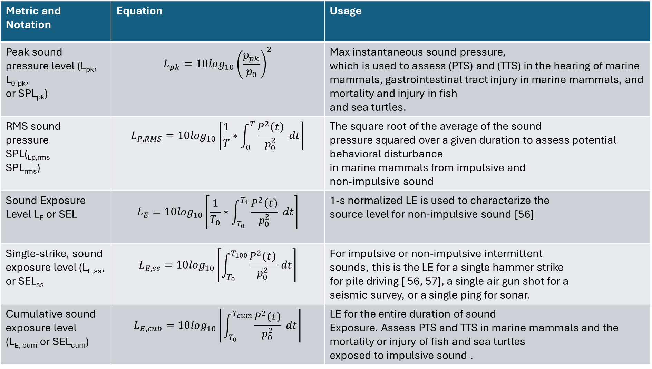
Metric and Notation | Equation | Usage
Peak sound pressure level (L_{pk}, L_{0-pk}, or SPL_{pk}) | $$L_{pk}=10\log_{10}{\left(\frac{p_{pk}}{p_{0}}\right)}^{2}$$ | Max instantaneous sound pressure, which is used to assess (PTS) and (TTS) in the hearing of marine mammals, gastrointestinal tract injury in marine mammals, and mortality and injury in fish and sea turtles.
RMS sound pressure SPL(_{Lp,rms} SPL_{rms}) | $$L_{P,RMS}=10\log_{10}\left\lceil \frac{1}{T}∗\int_{0}^{T}{\frac{P^{2}\left(t\right)}{p_{0}^{2}}} dt\right\rceil$$ | The square root of the average of the sound pressure squared over a given duration to assess potential behavioral disturbance in marine mammals from impulsive and non-impulsive sound
Sound Exposure Level L_{E} or SEL | $$L_{E}=10\log_{10}\left\lceil \frac{1}{T_{0}}∗\int_{T_{0}}^{T_{1}}{\frac{P^{2}\left(t\right)}{p_{0}^{2}}} dt\right\rceil$$ | 1-s normalized LE is used to characterize the source level for non-impulsive sound [56]
Single-strike, sound exposure level (L_{E,ss}, or SEL_{ss} | $$L_{E,ss}=10\log_{10}\left\lceil \int_{T_{0}}^{T_{100}}{\frac{P^{2}\left(t\right)}{p_{0}^{2}}} dt\right\rceil$$ | For impulsive or non-impulsive intermittent sounds, this is the LE for a single hammer strike for pile driving [ 56, 57], a single air gun shot for a seismic survey, or a single ping for sonar.
Cumulative sound exposure level (L_{E, cum} or SEL_{cum}) | $$L_{E,cub}=10\log_{10}\left\lceil \int_{T_{0}}^{T_{cum}}{\frac{P^{2}\left(t\right)}{p_{0}^{2}}} dt\right\rceil$$ | LE for the entire duration of sound Exposure. Assess PTS and TTS in marine mammals and the mortality or injury of fish and sea turtles exposed to impulsive sound .
https://tethys.pnnl.gov/sites/default/files/publications/jmse-09-00173.pdf

Slide 24
Next week
Sound measurements
Journal club (volunteers?)

Slide 25
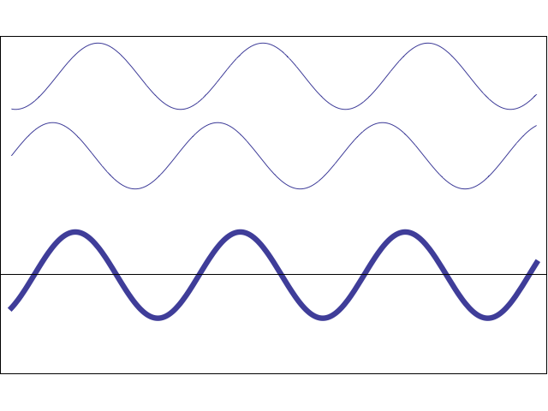
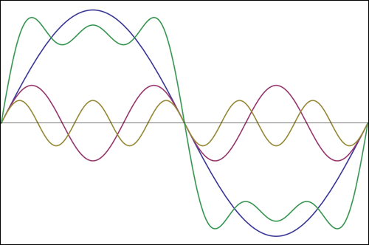
Interactions
Most sound combination of different harmonic waves at different amplitudes and frequencies
Results in constructive and destructive interference
Can sum multiple harmonic waves to make any shape
$A\sin\left(ωt±kx\right)+A\sin\left(ωt±kx+φ\right)=2A\cos\left(\frac{φ}{2}\right)∗\sin\left(ωt±kx+φ/2\right)$

Slide 26
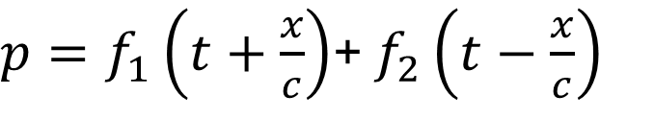
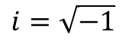
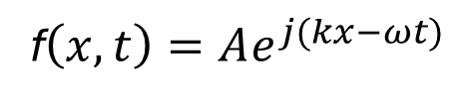
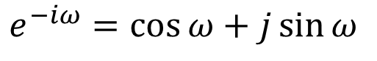
Important Relationships:
Wave moving +x
Wave moving -x
c =λf
k=ωc, ω = c/k
k=2π/ λ
$p=f_{1}\left(t+\frac{x}{c}\right)$+ $f_{2}\left(t−\frac{x}{c}\right)$
Some fun. f₁
Some fun. f₂
f$\left(x,t\right)=Ae^{j(kx−ωt)}$
$$i=\sqrt{−1}$$
Real part (amplitude)
$e^{−iω}=\cos{ω⁡}+j\sin{ω}$
Imaginary/complex part (phase)

